Slide 1
Tesla
Community Solar
Jerry Yip
jerry.yip@gmail.com

Slide 2

Tesla’s mission is to accelerate the world’s transition to sustainable energy.

Slide 3
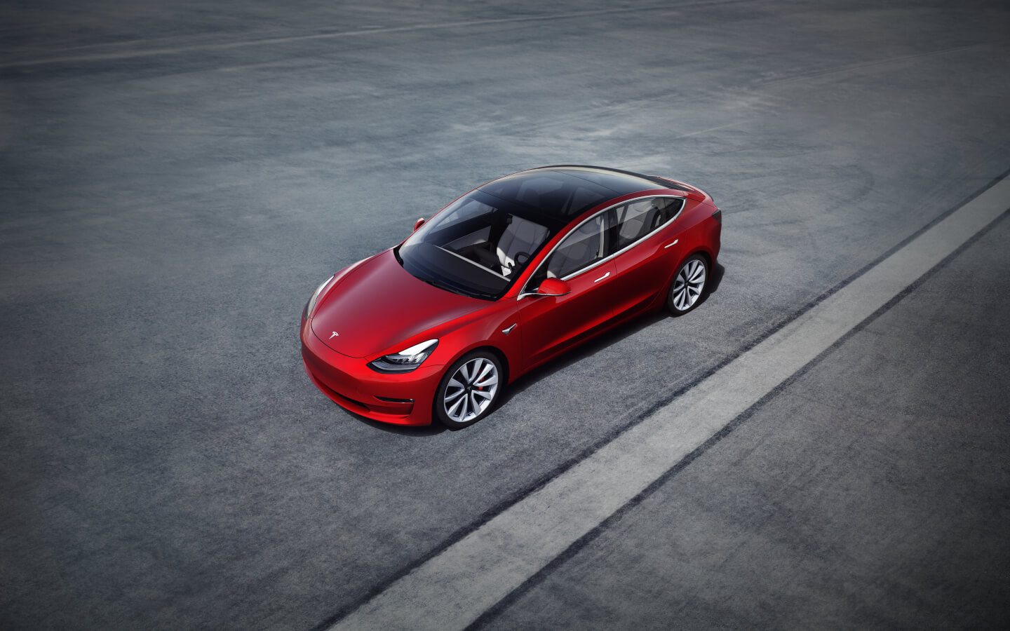
Tesla Cars
Tesla Cars
Notes:
Most people know Tesla because of their cars

Slide 4
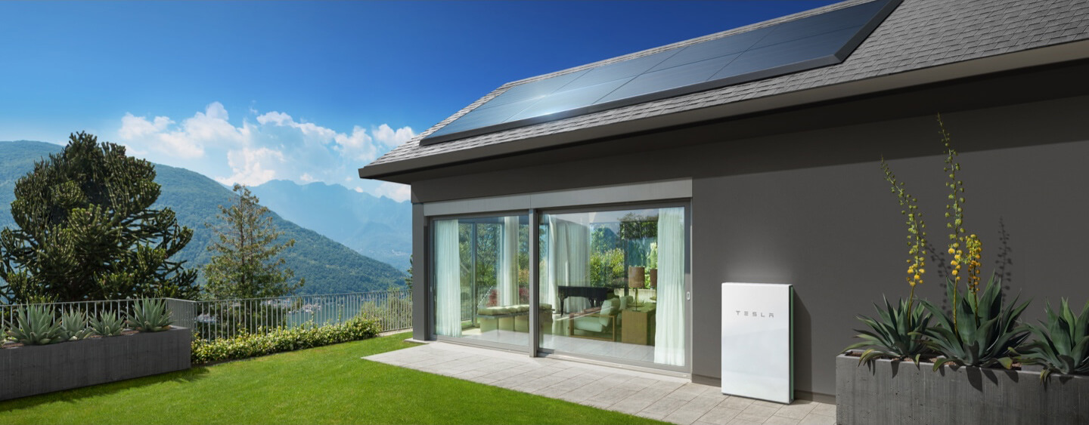
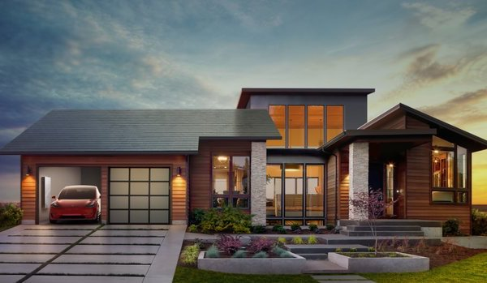
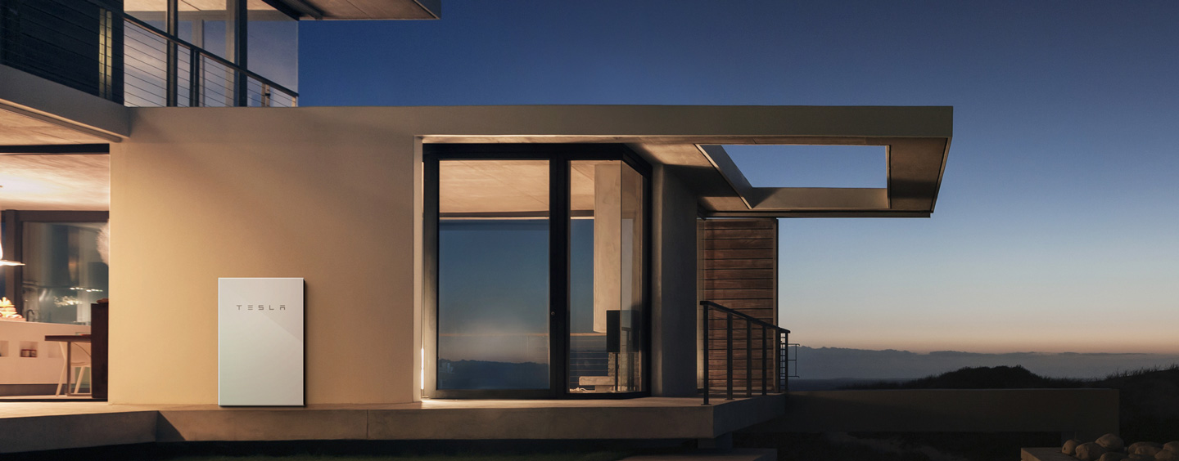
Tesla Energy
Tesla Solar Panels
Tesla Solar Roof
Tesla Home Batteries
Notes:
However as per Tesla’s mission, they also provide an array of residential (e.g. solar panels/roof tiles/home batteries) and commercial/industrial energy products (e.g. powerpack etc.)

Slide 5
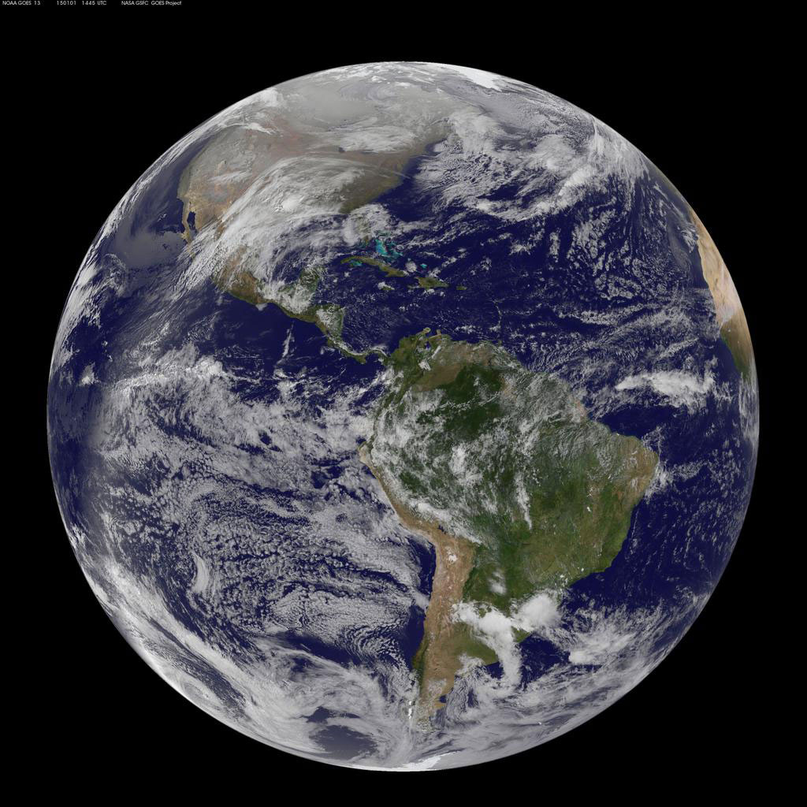
Environment
Notes:
What’s on many people’s minds these days is climate change and the environment

Slide 6
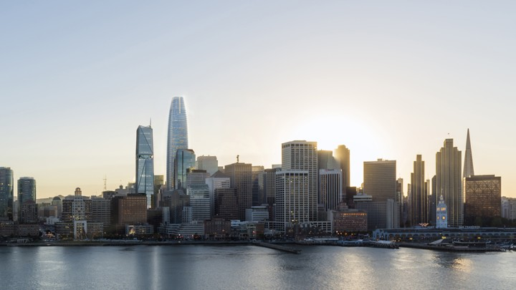
Modern Day Living
Notes:
Modern day living means many people live in condos/apartment complexes especially in urban areas.

Slide 7
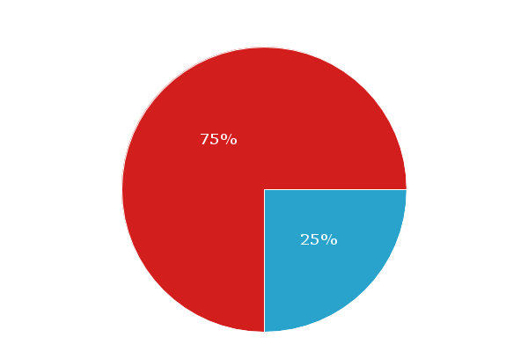
Statistics
~77% of homes can’t support solar
https://solstice.us/solstice-blog/why-americans-cant-access-rooftop-solar/
Notes:
Whether because customers live in multi-unit housing complexes or because their roof doesn’t have sufficient sun exposure, studies show there is a large percentage of people who can’t install solar on their current residences -- hence a huge untapped opportunity

Slide 8
Opportunity Hypothesis
Community Solar

Slide 9
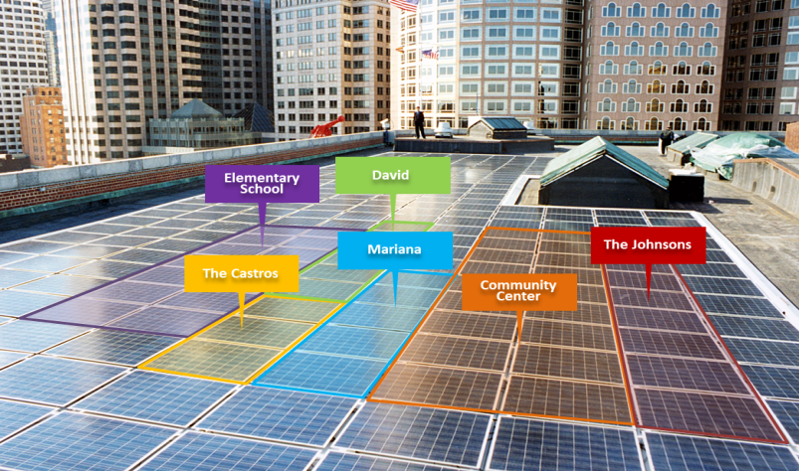
Community Solar

Slide 10
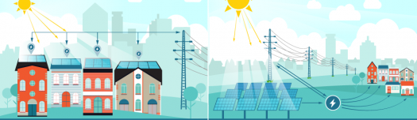
Community Solar
Recent Market Success
New York
Minnesota
New York Times: https://www.nytimes.com/2018/07/12/realestate/apartment-dwellers-solar-power.html
“guaranteeing a 10 to 15% reduction to a customer’s monthly electricity bill”
Notes:
California market also exists (huge opportunity), although regulatory environment may need further improvements (bureaucracy) along with customer education.

Slide 11
SWOT
Strengths: In-house solar & battery expertise Huge existing customer base Brand recognition | Weaknesses Tesla new to Community Solar
Opportunities: Untapped Market Potential Cost Savings to Customers | Threats Several Incumbents (potential partners?)

Slide 12
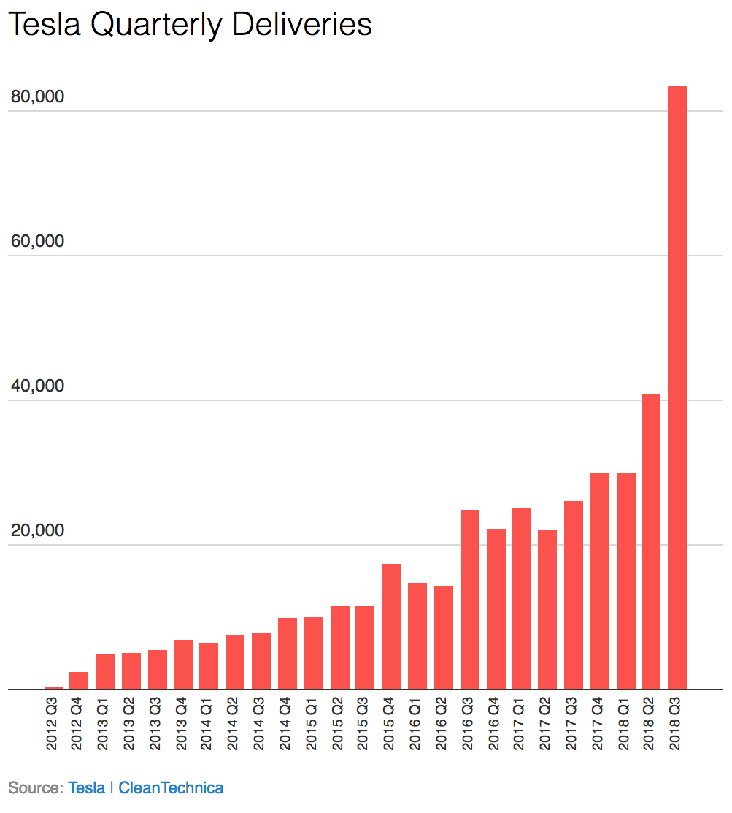
Tesla Customers
As of Q2 2018: 500,000 vehicles sold in the US alone
Notes:
Strategy: can cross sell to exponentially growing customer base of Tesla vehicle owners, minimizing marketing costs and targeting an already invested customer base who believe in the product and would also be interested in (1) reducing their energy bill and (2) improving environment

Slide 13
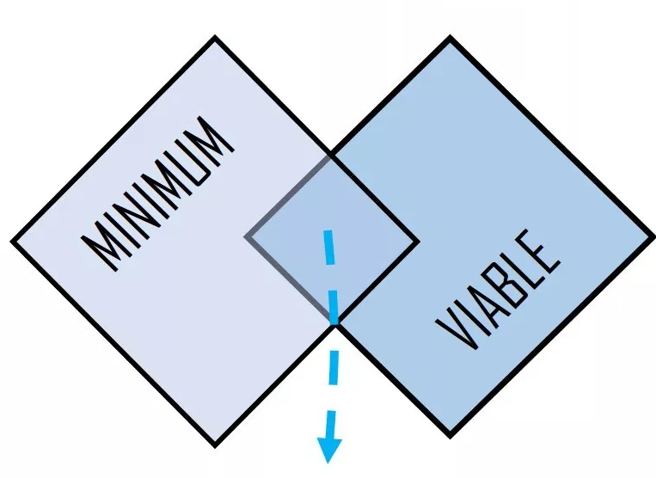
Minimum Viable Product
Cross-sell to existing Tesla car owners in select markets
Notes:
by targeting existing car owners this also allows initial MVP release to only comprise updates to Tesla mobile app (e.g. for existing car owners)

Slide 14



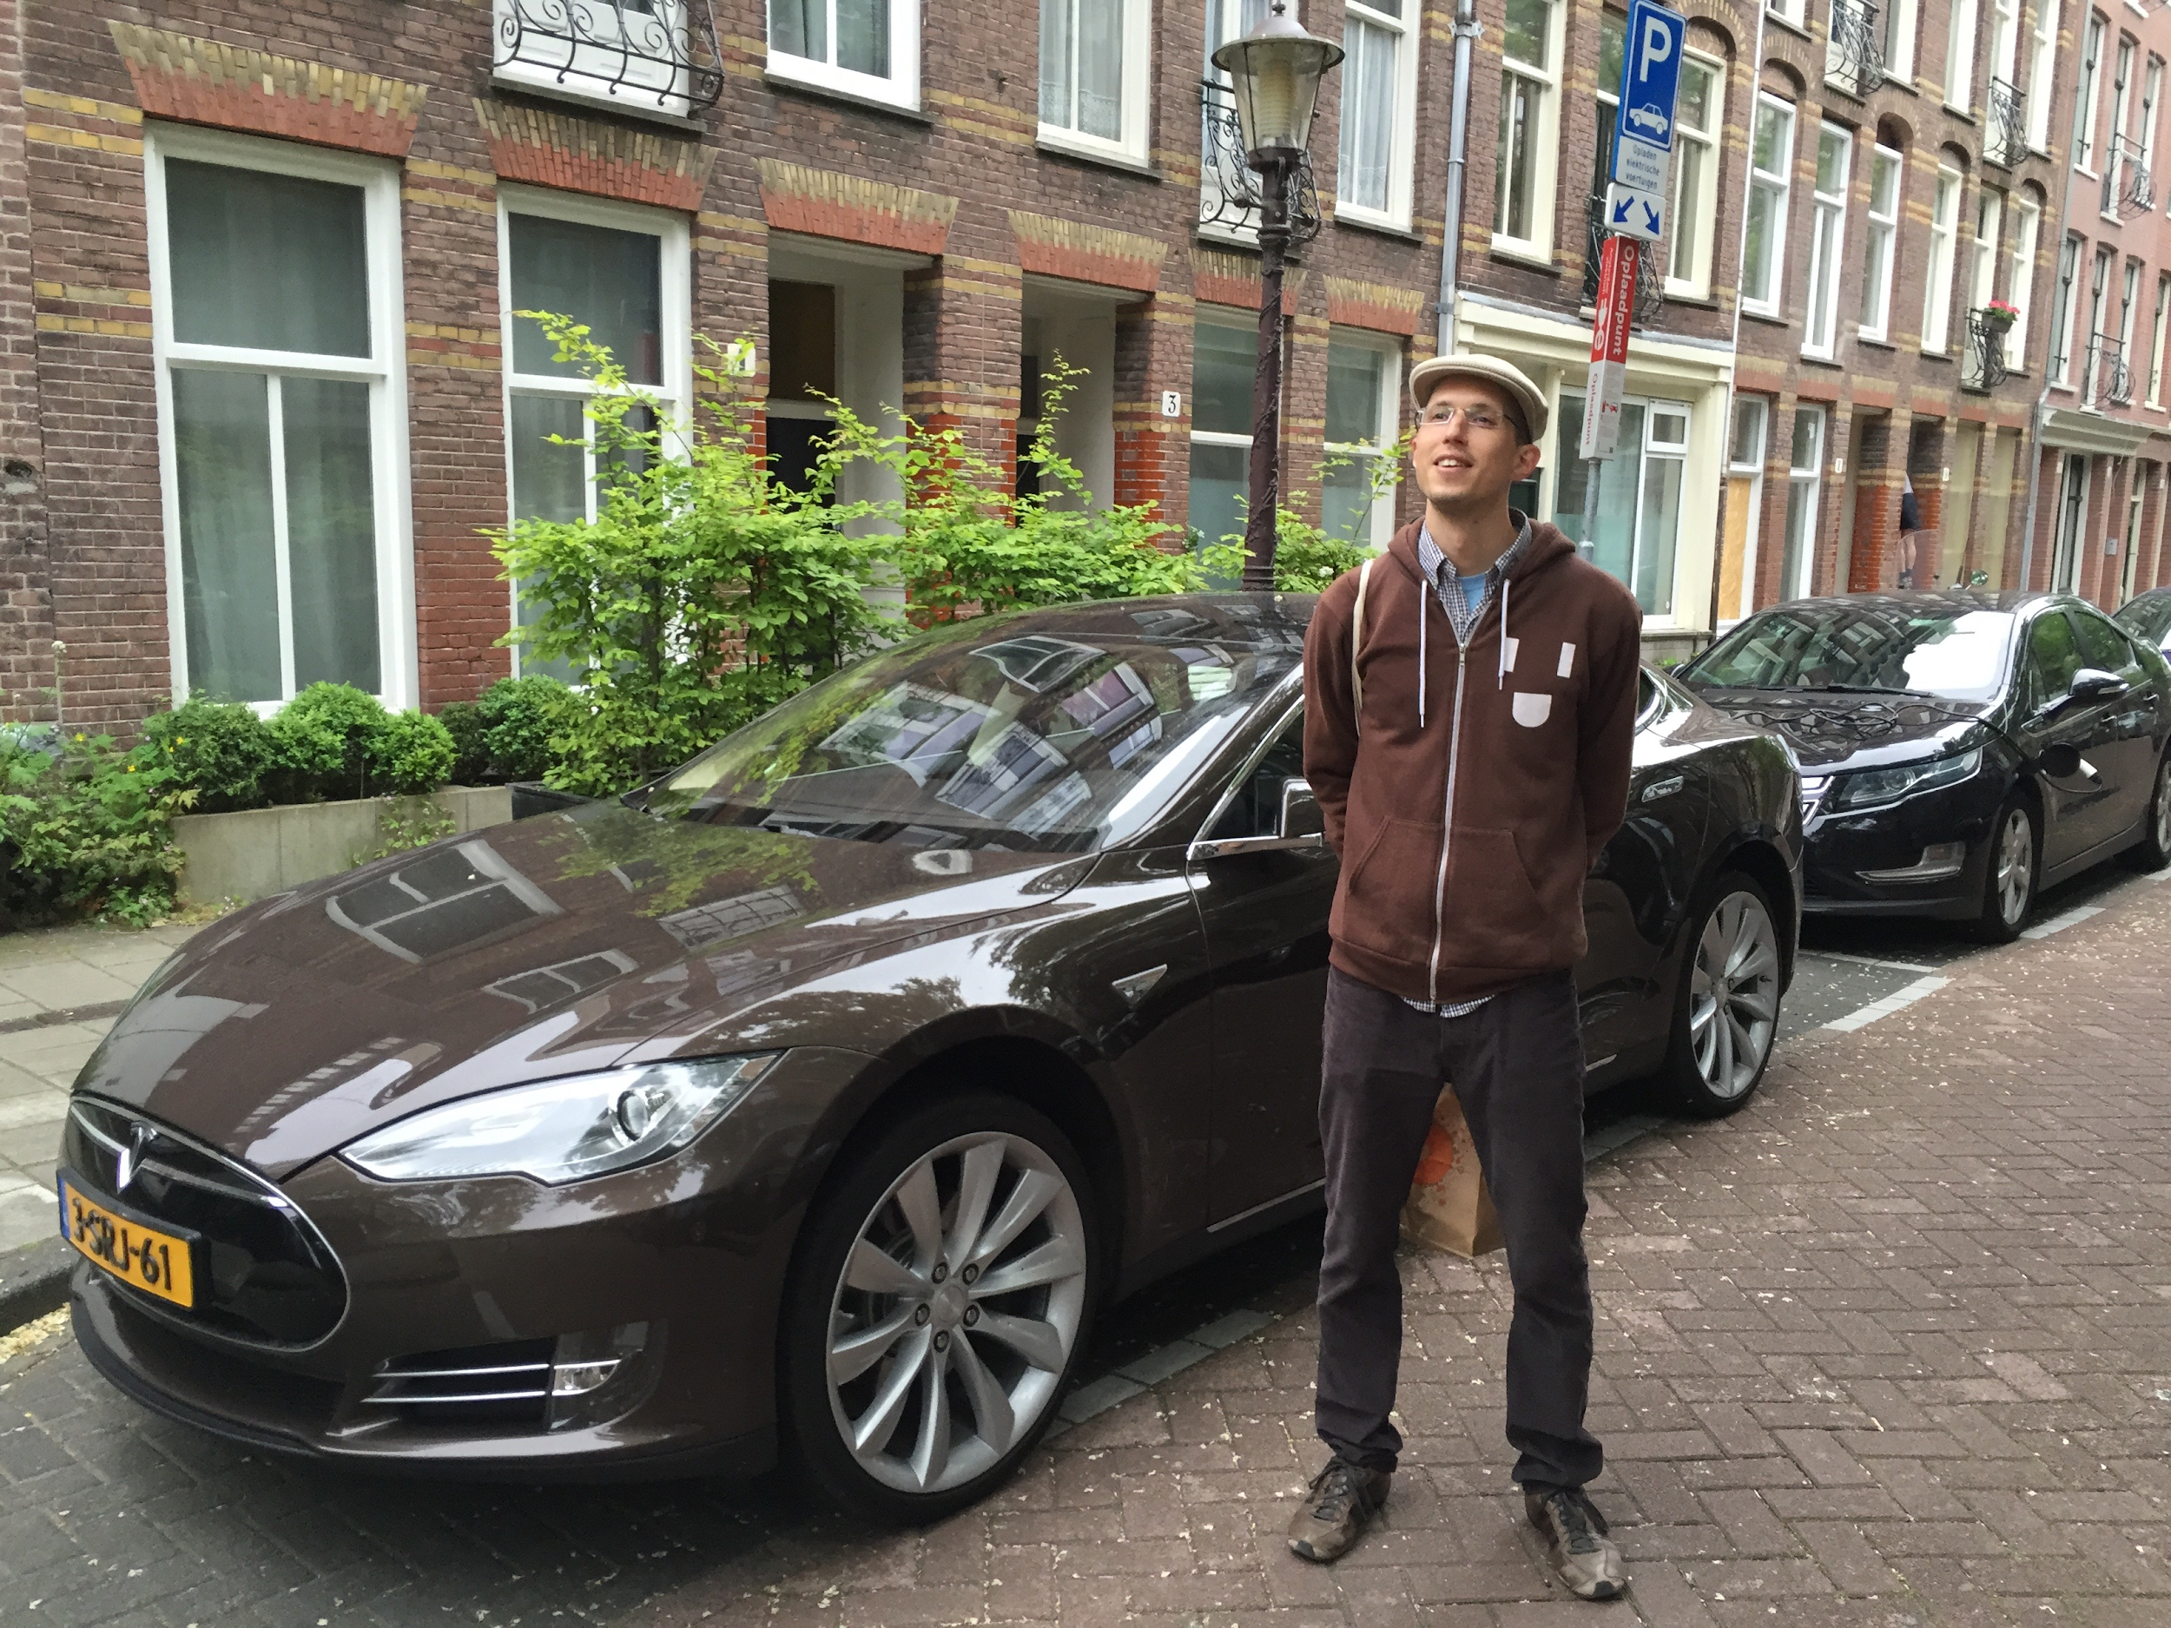
Target Personas
Notes:
Persona 1 (on left): customers signing up for energy supply via community solar - further breakdown as follows:
People who rent or live in apt/condo
in particular Tesla owners
People who can’t afford to/don’t want to commit to installing solar
in particular Tesla owners
People who aren’t currently interested in installing solar, but wouldn’t mind additional monthly revenue
Persona 2 (on right): customers installing community solar panels -- further breakdown as follows:
Nearby business owners with unused roof capacity (warehouses/retail/factories etc.)
Nearby homeowners who can install solar or can increase amount of solar on existing roof installation

Slide 15

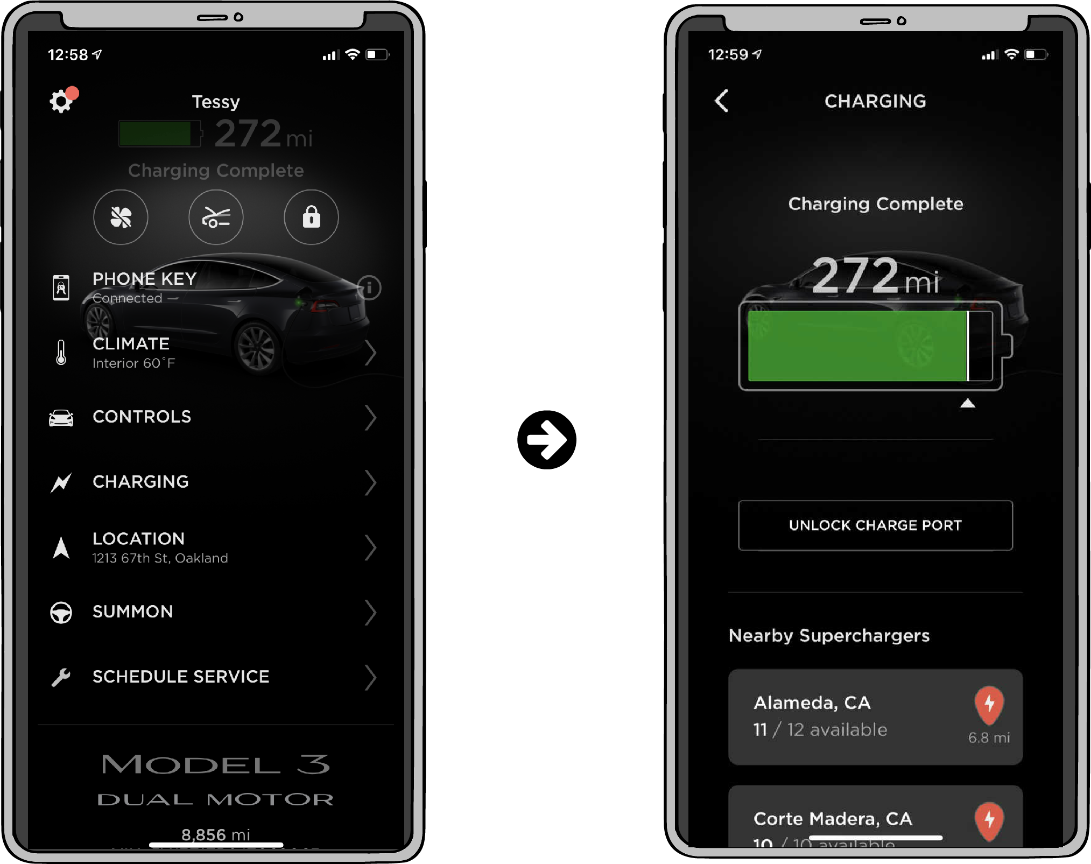
Tesla Mobile App
Notes:
Schreenshots of existing Tesla mobile app as of March 2019

Slide 16
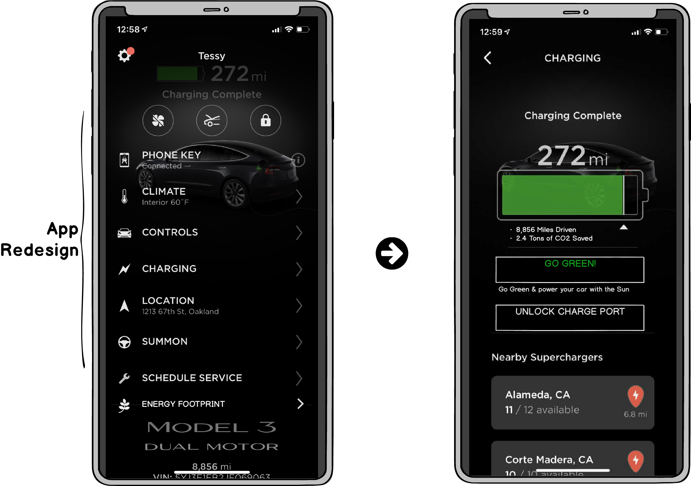
Updates
Notes:
New links promoting Community Solar (and regular solar): “Energy Footprint” and “Go Green”

Slide 17
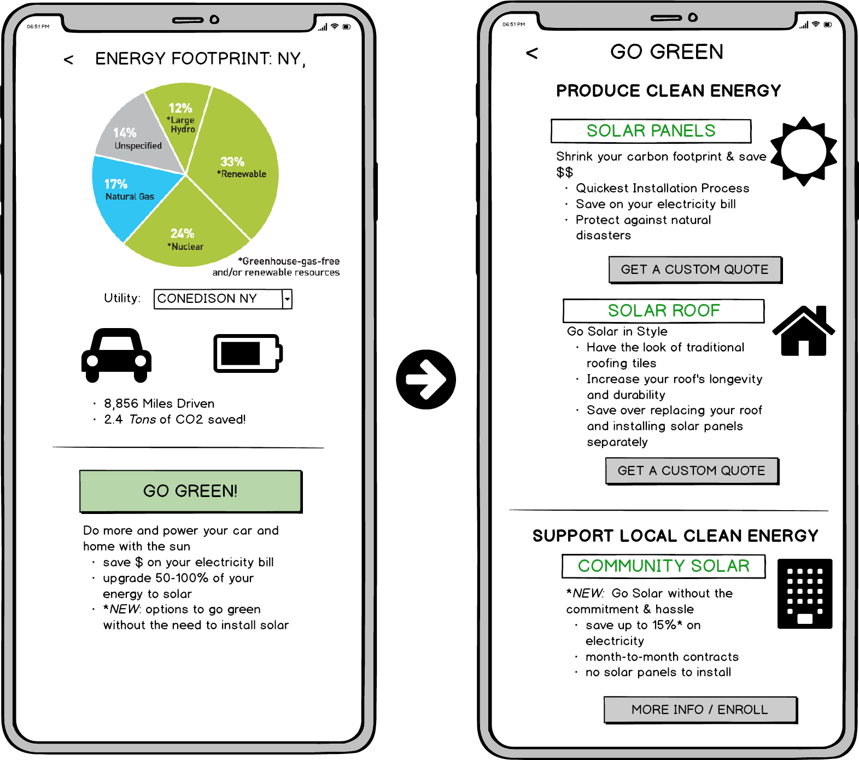
New Pages
Notes:
New pages on mobile app (can also be replicated for web app if successful)

Slide 18
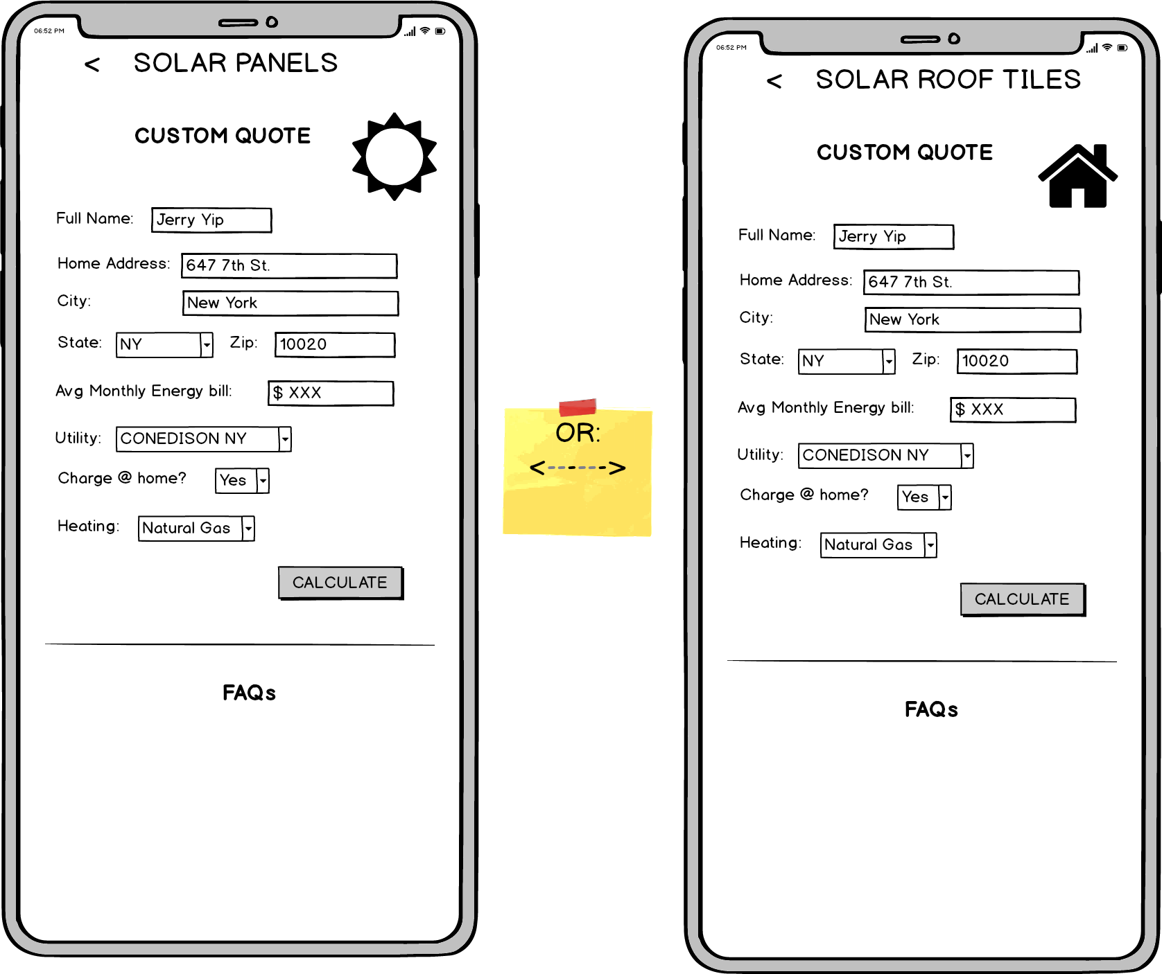
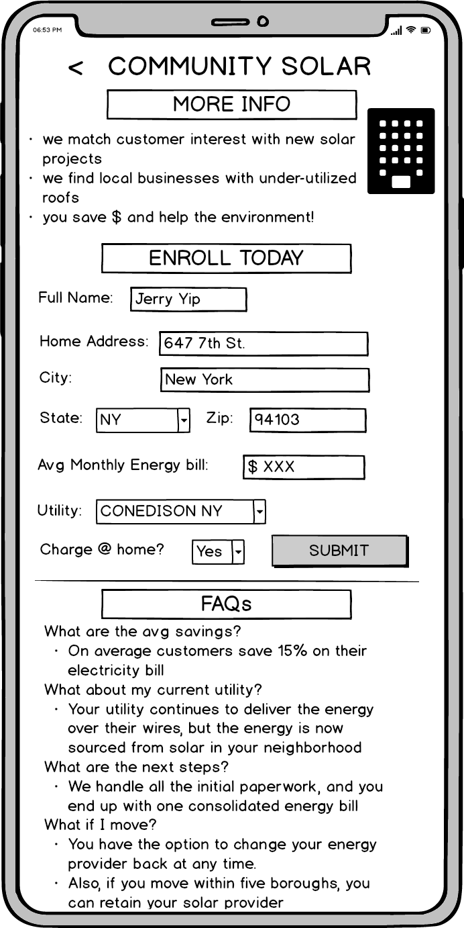

New Pages (cont.)
Notes:
Customer funnel - can initially just gauge interests with information and/or cost quote requests
If desired, can buildout workflow for actual sign-ups

Slide 19
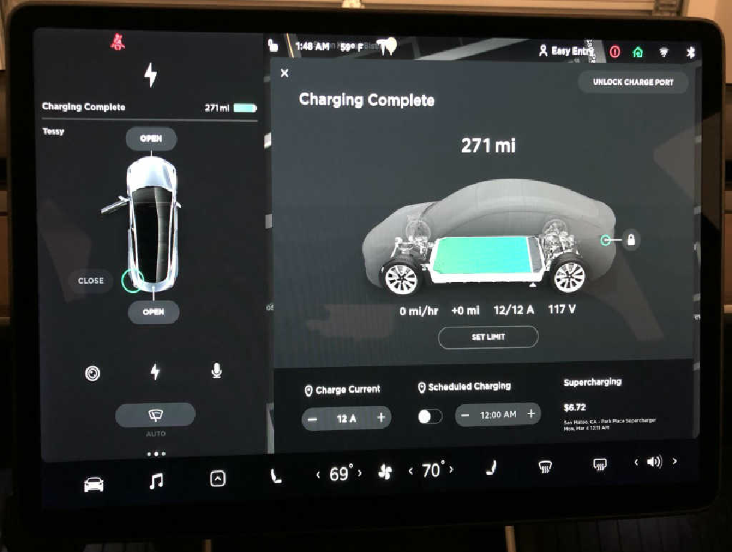
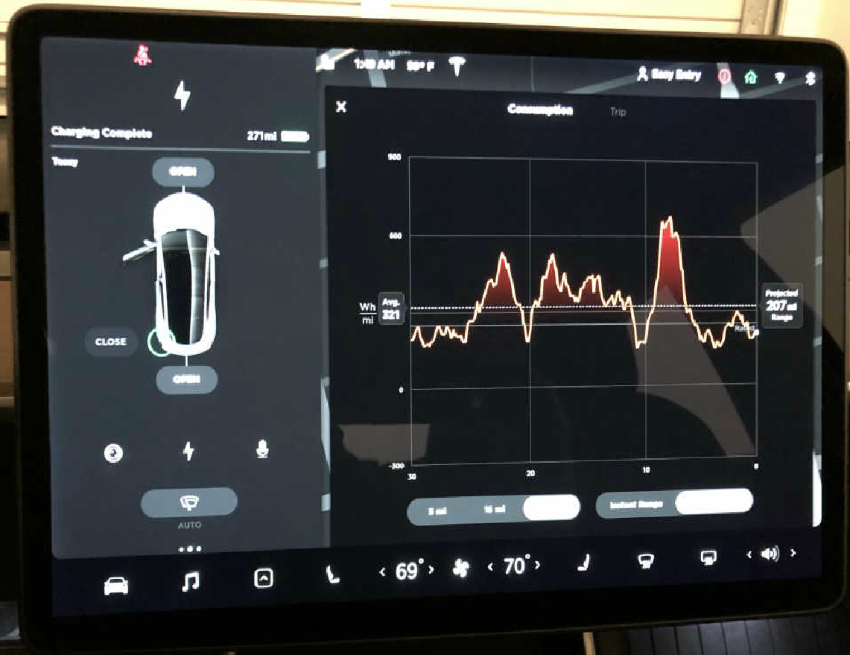
Beyond the MVP
Notes:
Going beyond the MVP can replicate some of the same functionality into in-car screen (e.g. showing energy source/ghg emissions for charging etc.) and/or web app.

Slide 20
Success Metrics
Number of customers who submit a request to enroll in community solar
Number of community solar projects started
Number of MWs of solar capacity and storage installed for community solar projects
Total number of new Tesla customers who install Tesla solar and batteries on their residence (whether individually or as part of community solar project)
Total MWs of solar installed

Slide 21
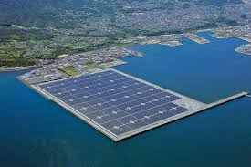
Earth’s Power Plant
Future markets:
California
Rest of US
Internationally
Notes:
“You only need about 100 miles by 100 miles of solar panels to power the entire United States. The batteries you need to store the energy, to make sure you have 24/7 power, is 1 mile by 1 mile. One square-mile. That’s it.” — Elon Musk

